Slide 1
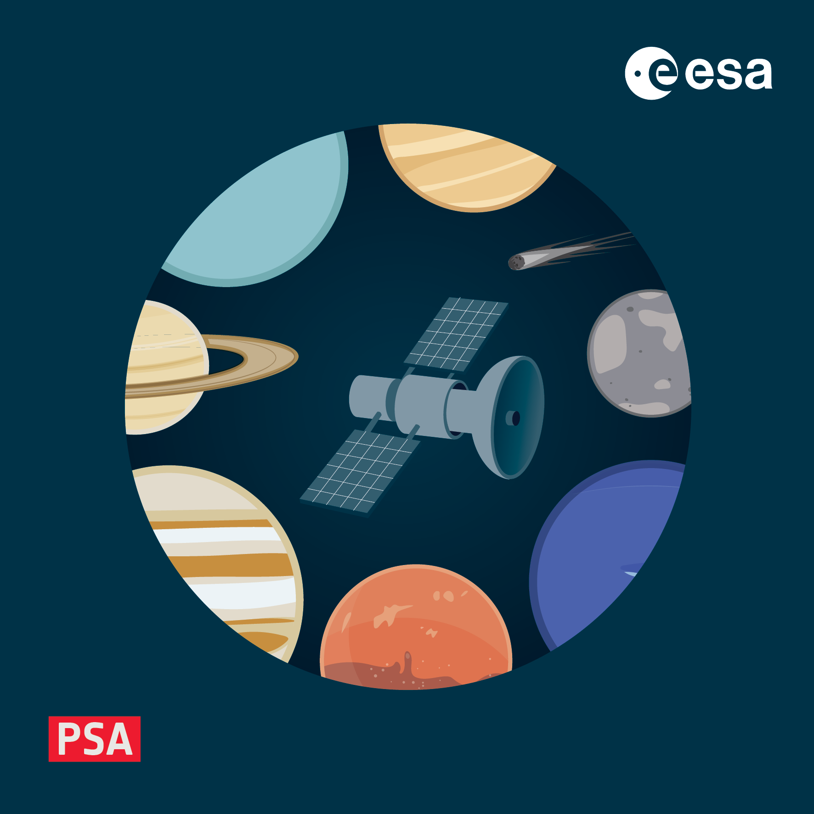
PDS4 training workshop
Mission and instrument dictionaries
4-8 November 2024, ESAC, Spain

Slide 2
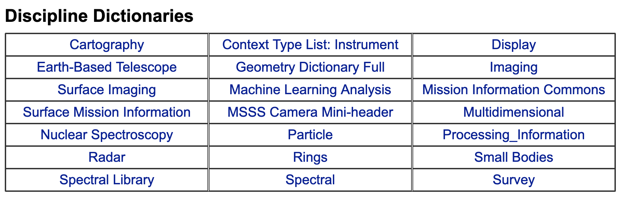
The need for additional dictionaries
NASA PDS nodes have a staggering 21 discipline dictionaries to choose metadata from
Even so, each mission and instrument is different and defining ad hoc metadata can be useful
Mission dictionaries for ESA missions are generated and maintained at ESAC
PSA has its own dictionary and is considered a mission dictionary by NASA PDS as PSA is not a PDS node
Instrument dictionaries can be generated by the Archive Scientist or the P.I. team in agreement with the AS
They live in the PSA and can be retrieved from https://psaftp.esac.esa.int/

Slide 3
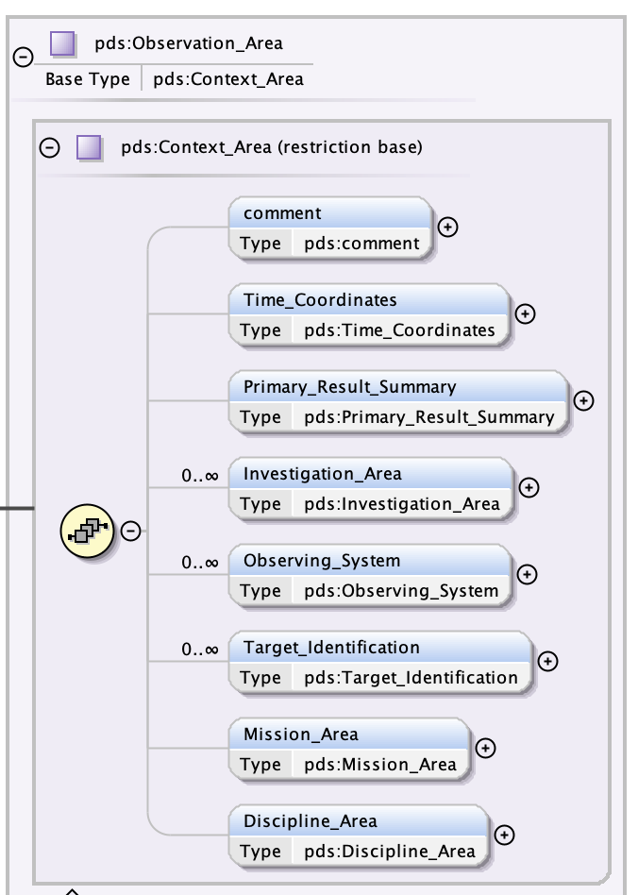
Where do they go in product labels?
PDS is highly structured, each item has its own place fixed by the Information Model e.g.
Place for metadata from mission and instrument dictionaries
Place for metadata from discipline dictionaries

Slide 4
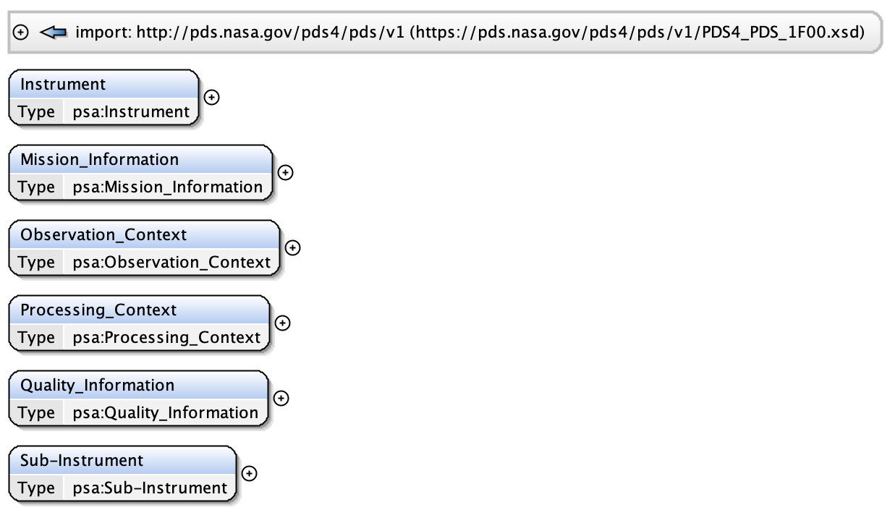
The PSA dictionary – The Schema
It is a dictionary generated at ESAC, common and mandatory to all missions
Past and current PSA dictionaries: https://psaftp.esac.esa.int/#/psa_master/xml_schema/
The schema contains the following classes
Optional
Mandatory

Slide 5
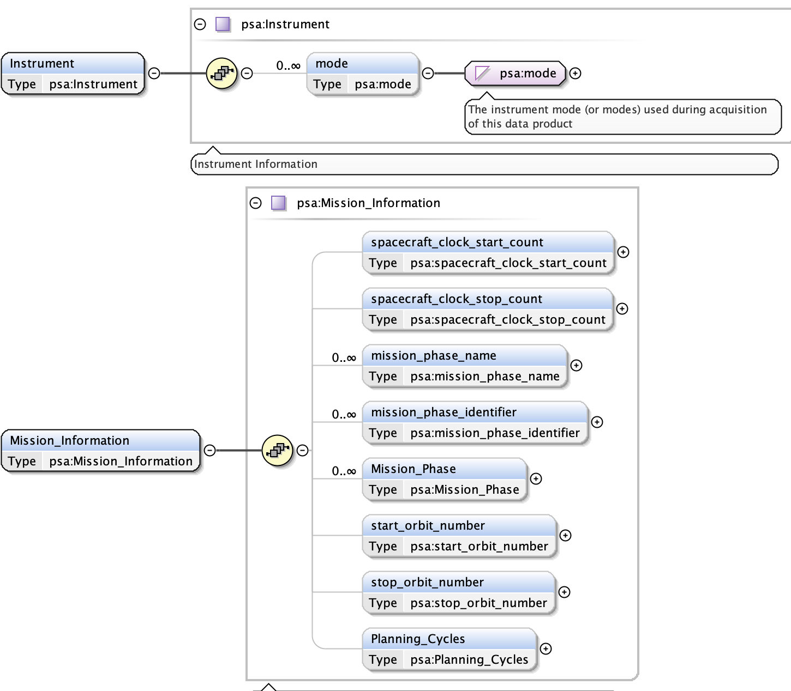
PSA dictionary – The Schema cont.
Not commonly used so far
Not mandatory but commonly used
Must either use mission_phase_name/identifier or the Mission_Phase class
See your mission schematron for phase names/ids
Not mandatory but commonly used
Rarely used (values=stp/mtp/ltp)

Slide 6
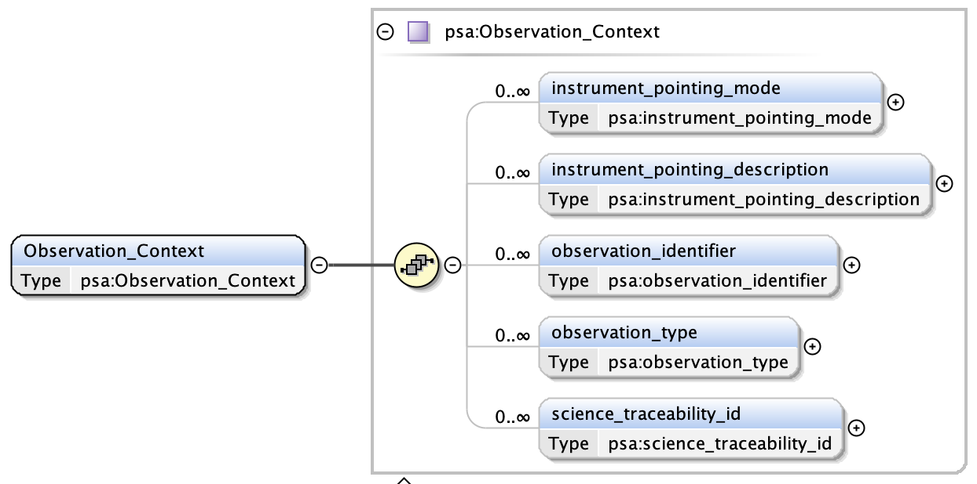
PSA dictionary – The Schema cont.
Optional, but for some instruments it might be useful to add e.g. the pointing mode as it could be used to quickly filter through the archive
The type of observation being
performed - mission and/or
instrument specific and values
may be further constrained in
mission/instrument dictionaries
The ID of an entry in the mission science traceability matrix satisfied, or attempted,
by observations in this product

Slide 7
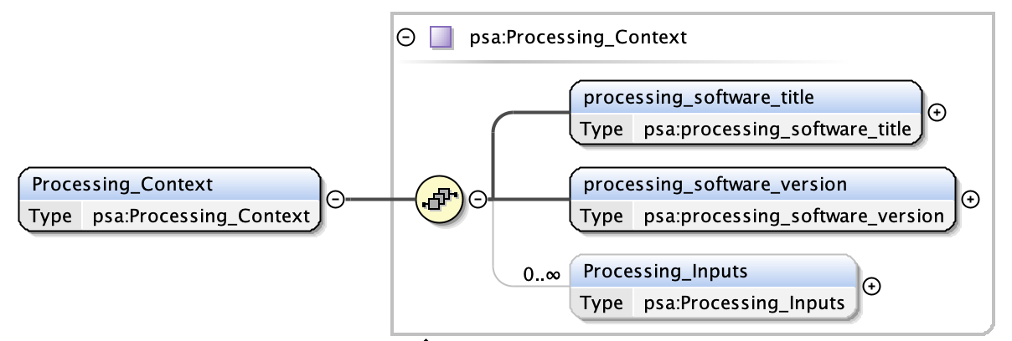
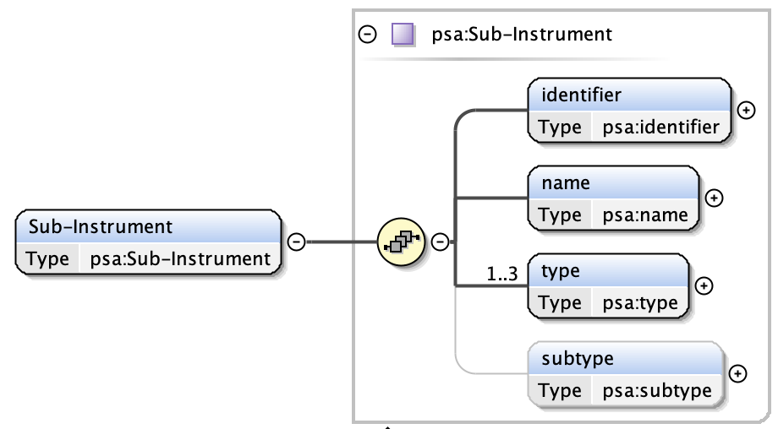
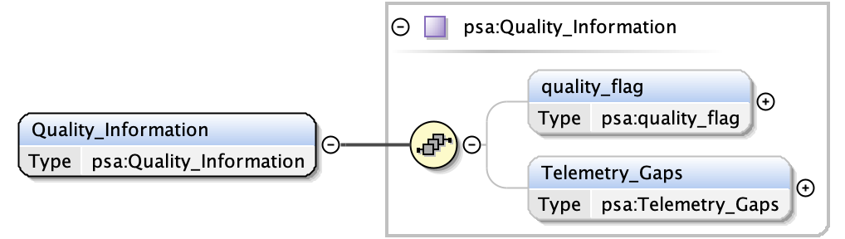
PSA dictionary – The Schema cont.

Slide 8
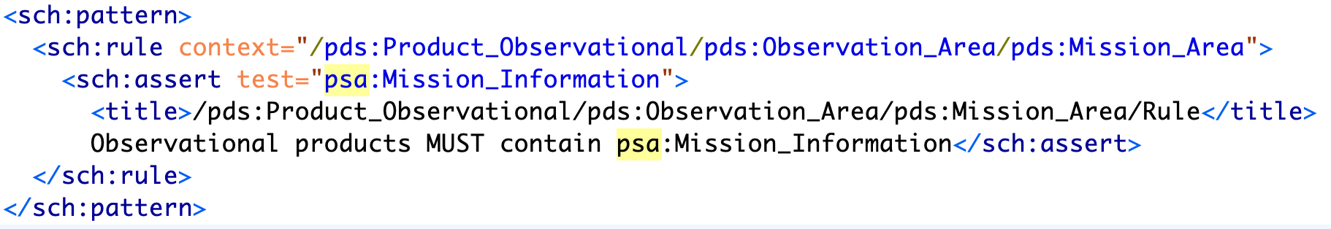
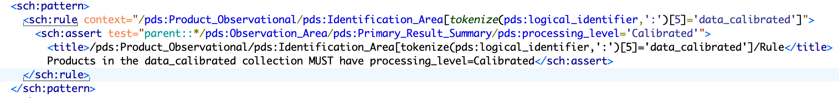
PSA dictionary – The Schematron
The PSA Schematron is as essential as the schema
It is the set of rules paired with the PSA schema and it ensures that classes/metadata/values are present and/or are correct, e.g.
Checks that Mission_Area
contains
the PSA class
Mission_Information
See splinter
on schematrons and xpaths on
Friday!
Checks that collection type (data_calibrated) matches
processing_level (Calibrated)

Slide 9
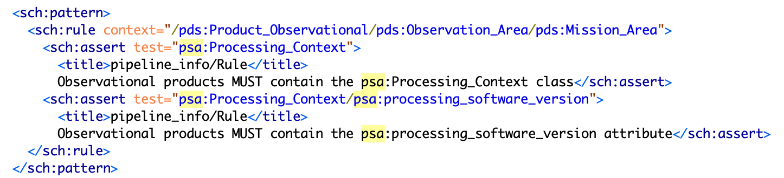
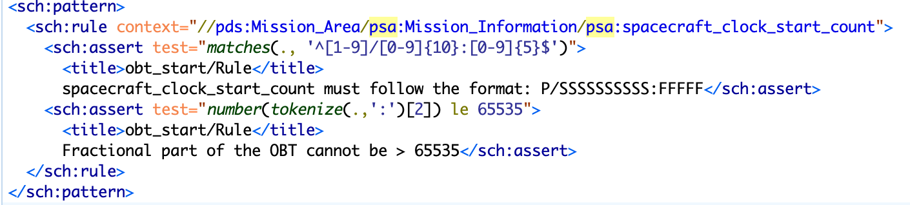
Mission dictionaries
Mission dictionary schemas could be empty, at least they are for ExoMars and BepiColombo
What is enforced via validation are the schematrons containing rules to be applied to the specific mission
For example (https://psaftp.esac.esa.int/BepiColombo/bc/xml_schema/PDS4_BC_1F00_1101.sch)

Slide 10
Instrument dictionaries
If instrument specific metadata are needed and are not already covered anywhere else, an instrument dictionary can be created in agreement with the Archive Scientist
Currently each instrument dictionary covers all sub-instruments as well
They must follow PDS4 rules (e.g. classes are capitalised, attributes are not; no blank spaces within the class/attribute names; type must be a PDS type like ASCII_Real, ASCII_NonNegative_Integer etc)
Lower and upper limits can be imposed to any given numerical attributes as well as a range of fixed values
A class/attribute can be made optional or mandatory
Nested classes are allowed (but do not abuse!!)
Best practices:
Group your metadata so that it makes sense, avoid dispersing information in labels
Write standalone descriptions for each metadata and expand as needed in the Data User Guide, including usability and relevance
Don’t overcomplicate

Slide 11
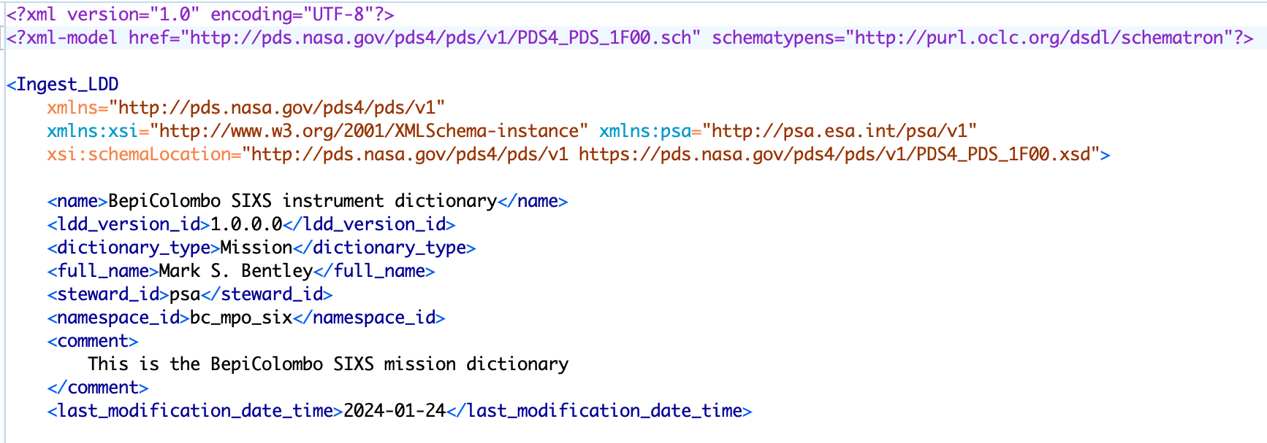

Instrument dictionaries – cont.
Instrument dictionaries are created using NASA LDD tool
https://nasa-pds.github.io/pds4-information-model/model-lddtool/index.html
The tool needs a predefined input file called the Ingest_LDD file, containing the classes and attributes that are wanted in the dictionary. Use is e.g. simply: lddtool -pdl Ingest_LDD file

Slide 12
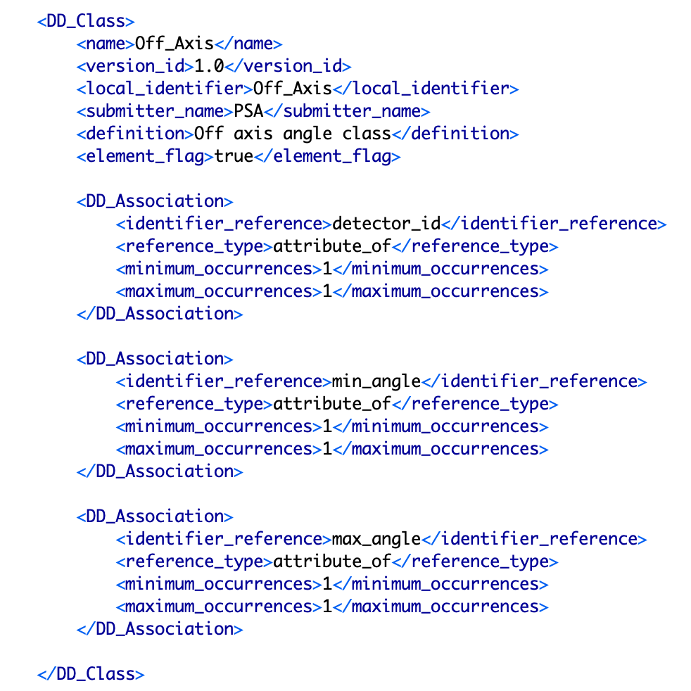
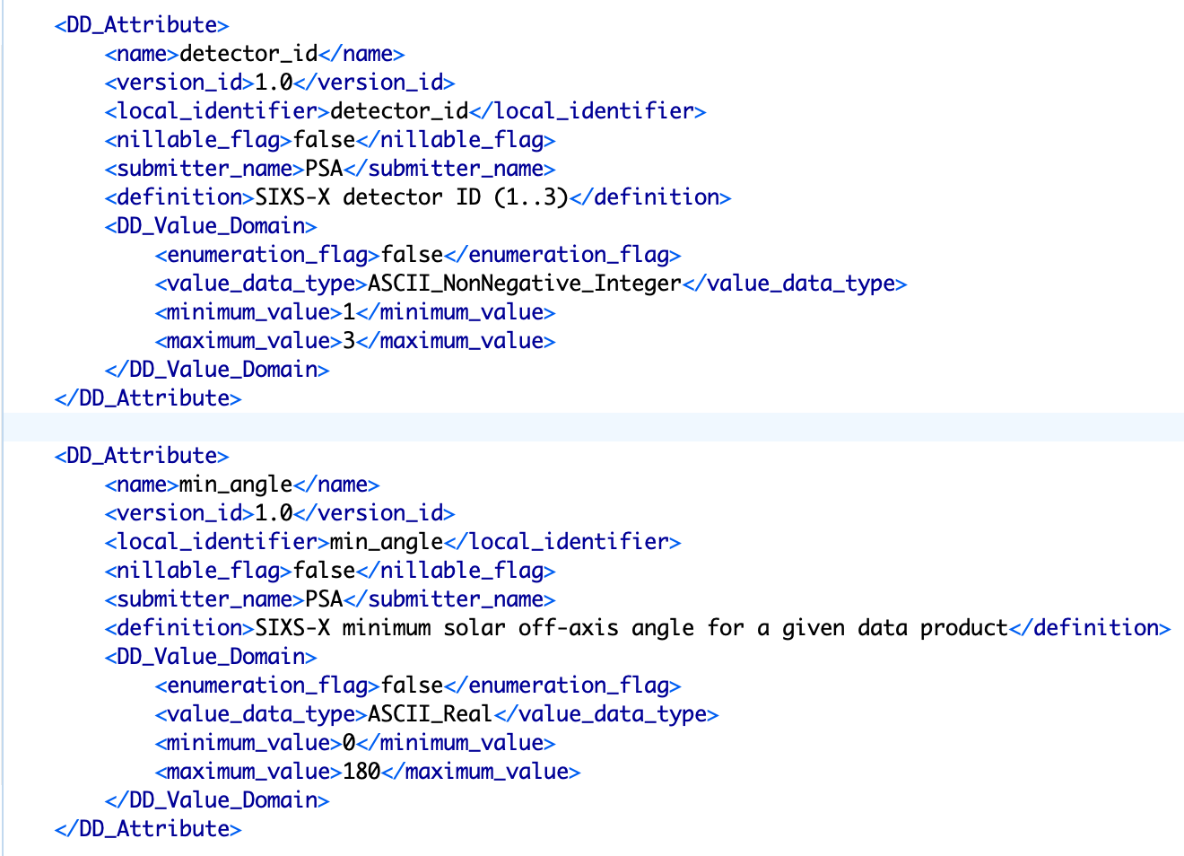
Instrument dictionaries – cont.

Slide 13
Instrument dictionaries – cont.
Important: The instrument namespace must be registered in the PSA registry otherwise LDDTool will default to the NASA namespace (http://pds.nasa.gov/pds4/pds/v1) instead of the intended one (e.g. http://psa.esa.int/psa/bc/mpo/mag/v1)
The Archive Scientist will register the namespace at the beginning of the mission
Lddtool will output several files, but the most important and of normal use are the schema and accompanying schematron
For example running the lddtool on the ingest file Ingest_PDS4_PSA_BC_MPO_SIX_1000.xml for BepiColombo (BC) instrument (SIXS) on board the MPO module returns:
PDS4_BC_MPO_SIX_1F00_1000.csv -> CSV file listing all classes and attributes
PDS4_BC_MPO_SIX_1F00_1000.sch -> Schematron
PDS4_BC_MPO_SIX_1F00_1000.txt -> text file listing all classes and attributes
PDS4_BC_MPO_SIX_1F00_1000.xml -> the product XML label
PDS4_BC_MPO_SIX_1F00_1000.xsd -> Schema

Slide 14
Putting it all together in the label
All schemas and schematrons used in a product must be declared in the header of each label e.g.
<?xml version="1.0" encoding="UTF-8"?> <?xml-model href="https://pds.nasa.gov/pds4/pds/v1/PDS4_PDS_1F00.sch" schematypens="http://purl.oclc.org/dsdl/schematron"?> <?xml-model href="https://pds.nasa.gov/pds4/geom/v1/PDS4_GEOM_1F00_1910.sch" schematypens="http://purl.oclc.org/dsdl/schematron"?> <?xml-model href="https://psa.esa.int/psa/v1/PDS4_PSA_1F00_1300.sch" schematypens="http://purl.oclc.org/dsdl/schematron"?> <?xml-model href="https://psa.esa.int/psa/bc/v1/PDS4_BC_1F00_1100.sch" schematypens="http://purl.oclc.org/dsdl/schematron"?> <?xml-model href="https://psa.esa.int/psa/bc/mpo/mag/v1/PDS4_BC_MPO_MAG_1F00_1002.sch" schematypens="http://purl.oclc.org/dsdl/schematron"?>
<Product_Observational xmlns="http://pds.nasa.gov/pds4/pds/v1" xmlns:bc_mpo_mag="http://psa.esa.int/psa/bc/mpo/mag/v1" xmlns:geom="http://pds.nasa.gov/pds4/geom/v1" xmlns:psa="http://psa.esa.int/psa/v1" xmlns:xsi="http://www.w3.org/2001/XMLSchema-instance"
xsi:schemaLocation="http://pds.nasa.gov/pds4/pds/v1 https://pds.nasa.gov/pds4/pds/v1/PDS4_PDS_1F00.xsd http://pds.nasa.gov/pds4/geom/v1 https://pds.nasa.gov/pds4/geom/v1/PDS4_GEOM_1F00_1910.xsd http://psa.esa.int/psa/v1 https://psa.esa.int/psa/v1/PDS4_PSA_1F00_1300.xsd http://psa.esa.int/psa/bc/v1 https://psa.esa.int/psa/bc/v1/PDS4_BC_1F00_1100.xsd http://psa.esa.int/psa/bc/mpo/mag/v1 https://psa.esa.int/psa/bc/mpo/mag/v1/PDS4_BC_MPO_MAG_1F00_1002.xsd">
Schematrons locations
Namespaces declarations
Schemas locations

Slide 15
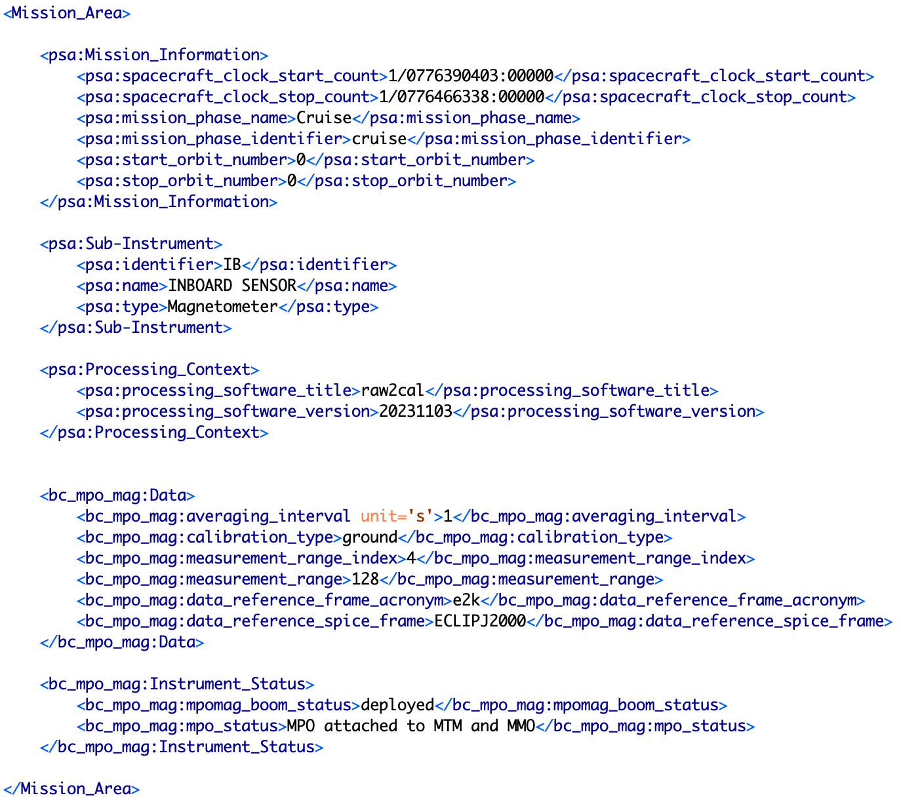
Putting it all together in the label – cont.
PSA dictionary
(at the top!)
Note: psa and
bc_mpo_mag
schemas/schematrons were
declared in the header
of the label file
Instrument
Dictionary

Slide 16
Takeaways
The PDS core and PSA/missions dictionaries are mandatory, instrument dictionaries are not
Before defining your own instrument dictionary, check if what you want is not already in one of the released dictionaries (PDS core, PDS disciplines, PSA)
Discuss with your Archive Scientist what is needed
Document it well in the Data User Guide
Think ahead – which metadata will improve data analysis and make your data sparkle?
Keep it simple (easy to maintain, easy to understand, easy to use)

Slide 18
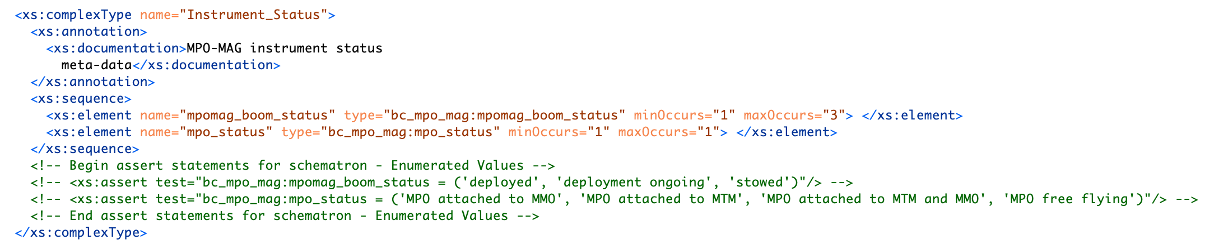

Instrument dictionaries – cont.
Example for mission BepiColombo, instrument mpo-mag, class Instrument_Status
How it appears in the schema
How it appears in the product
<?xml-model href="https://psa.esa.int/psa/bc/mpo/mag/v1/PDS4_BC_MPO_MAG_1F00_1002.sch" schematypens="http://purl.oclc.org/dsdl/schematron"?>
xmlns:bc_mpo_mag="http://psa.esa.int/psa/bc/mpo/mag/v1" xsi:schemaLocation=»http://psa.esa.int/psa/bc/mpo/mag/v1 https://psa.esa.int/psa/bc/mpo/mag/v1/PDS4_BC_MPO_MAG_1F00_1002.xsd">

Slide 19
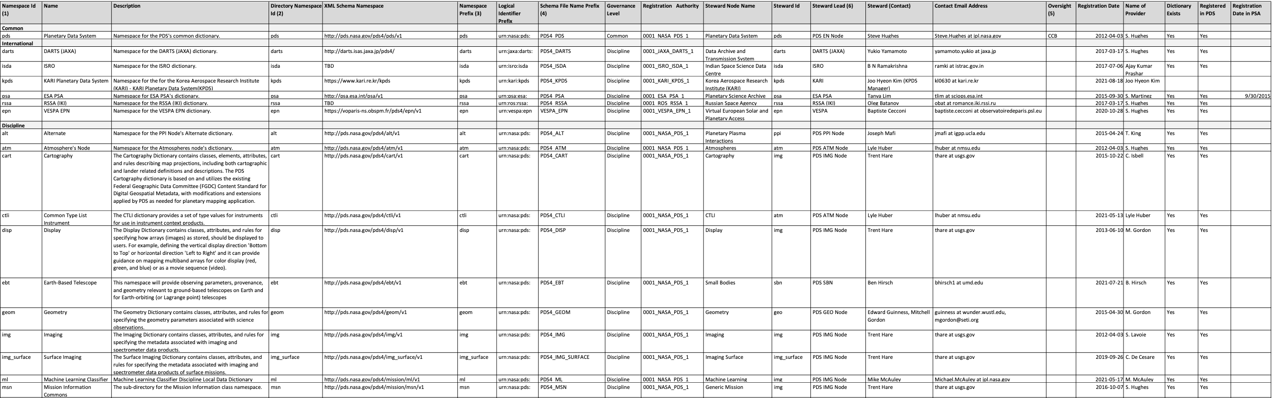
Namespaces and namespace registry – cont.
All namespaces should be in principle registered with the PDS Engineering Node (https://raw.githubusercontent.com/NASA-PDS/pds4-information-model/main/docs/namespace-registry/pds-namespace-registry.pdf)
But de facto, only agency level namespaces are registered outside of NASA so far

Slide 20
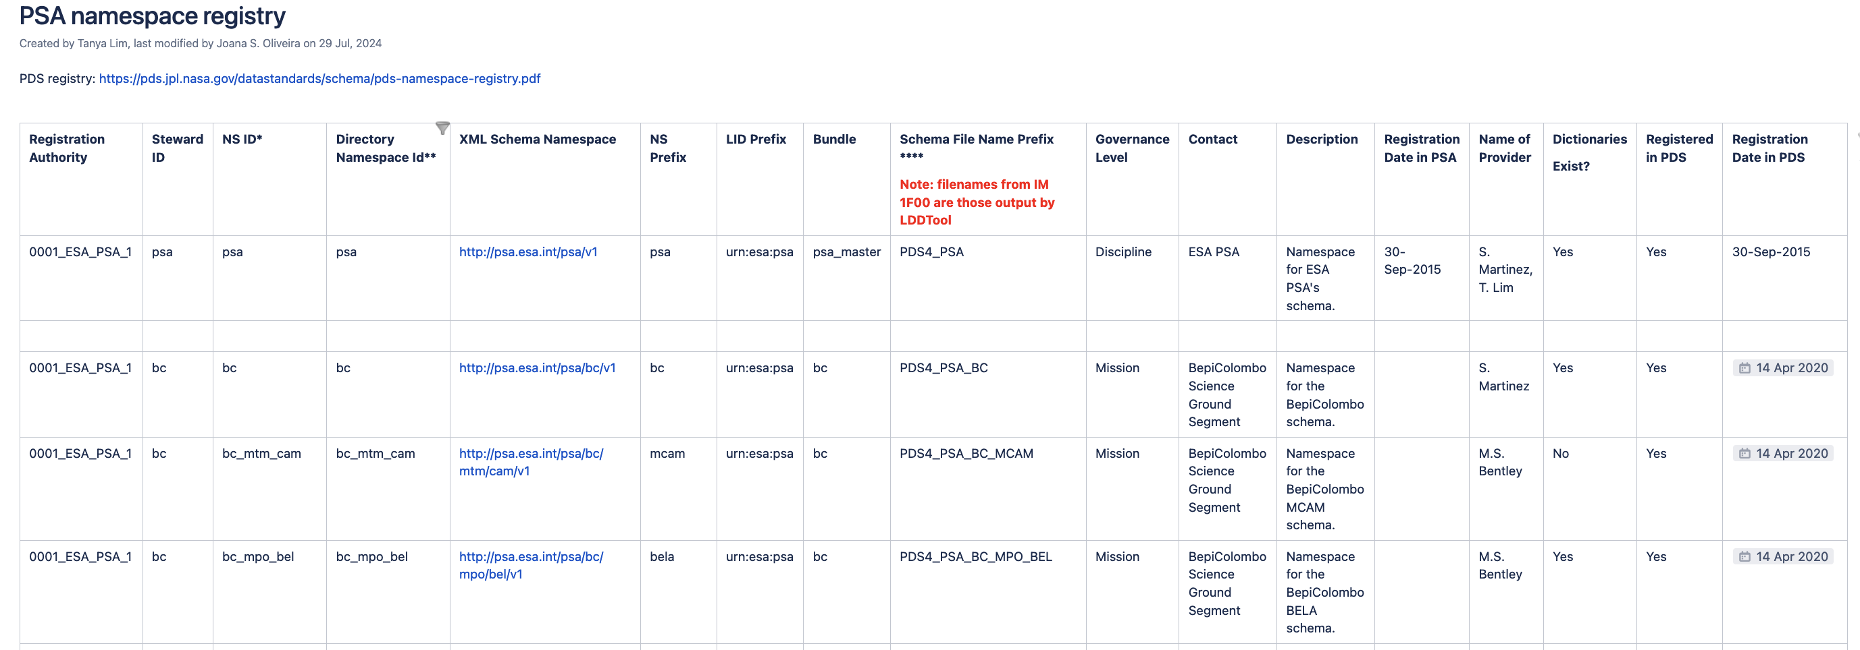
Namespaces and namespace registry – cont.
The PSA has namespaces defined and part of the PSA namespace registry for all current PDS4 missions (ExoMars, BepiColombo, Juice)
https://s2e2.cosmos.esa.int/confluence/display/PSAPUB1/PSA+namespace+registry

Slide 21
Namespaces and namespace registry – cont.
The advantage of having namespace is that any data dictionary referenced by a namespace can be used in a product and validated against that dictionary
Note the difference between namespace and physical location of the dictionary in the header of the label files:
namespace=http://pds.nasa.gov/pds4/pds/v1
schemaLocation="https://pds.nasa.gov/pds4/pds/v1/PDS4_PDS_1F00.xsd"

Slide 22
Namespaces and namespace registration
«Namespaces are a way to provide context for an XML element definition. Two elements with the same name but different namespaces are considered two completely different entities. For example, in the phrases "car title" and "movie title", the word title has two very different meanings»
«The XML Namespace standard defines an XML attribute, xmlns, that is used to identify a namespace and assign it an abbreviated prefix for easy reference throughout the document. Note that these namespace identifiers are formatted as URLs. The standard does not require that these URLs be resolvable» (https://pds.nasa.gov/datastandards/training/documents/Namespaces%20in%20PDS4.pdf)
Each namespace is associated with a dictionary and schematron so there are several namespaces (PDS core and discipline, PSA, missions, instruments) e.g
For PDS core dictionary it is (xmlns:pds=)"http://pds.nasa.gov/pds4/pds/v1"
For PDS discipline dictionaries is e.g. (xmlns:geom=)"http://pds.nasa.gov/pds4/geom/v1"
For the PSA dictionary it is (xmlns:psa=)"http://psa.esa.int/psa/v1"

